Slide 1
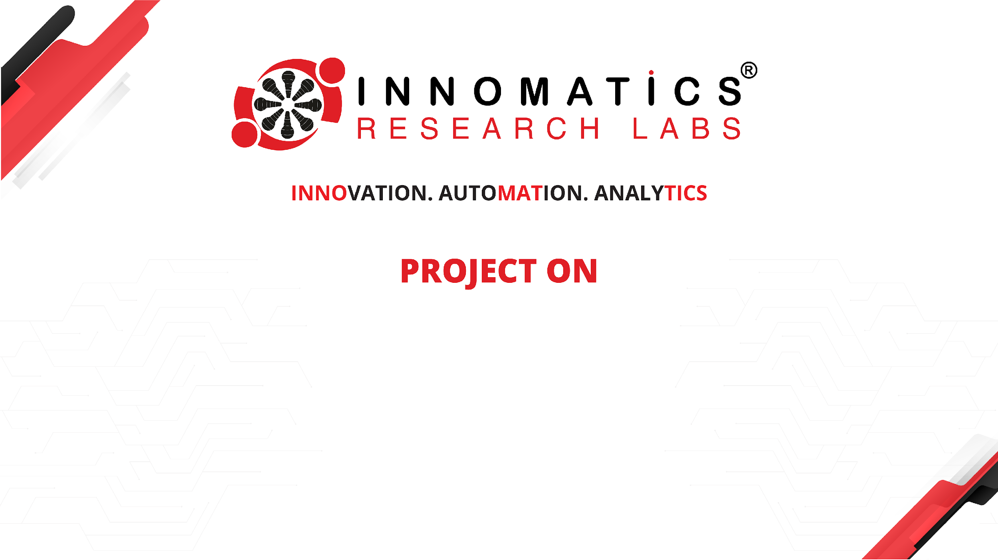
To-do list
using python and
streamlit
KASHAPNOR SANGAMESH
BATCH : 577

Slide 2
About Me
I’m KASHAPNOR SANGAMESH , I had recently completed my Bachelor’s Degree in Commerce from Veda Degree College.
Github: https://github.com/sangamesh1615-maker
LinkedIn: https://www.linkedin.com/in/sangamesh-kashapnor-4511173a7?utm_source=share_via&utm_content=profile&utm_medium=member_android
"I chose Data Analytics to gain analysis, practical, industry-relevant skills that help solve real-world problems through data."

Slide 3
Agenda
Business Problem
Business Statement
Business Requirements
Project Objective
Workflow Diagram
Insights
Recommendations
Conclusion

Slide 4
Many users face challenges managing their daily tasks using scattered notes or memory. This makes it difficult to keep track of pending work and upcoming deadlines. Important tasks can be forgotten or completed late. Without clear task statuses, users may lose track of what is already done. Finding a specific task among many can also take time. Managing task details and due dates manually can lead to confusion. Users need a simple to-do list to organize tasks, monitor progress, and stay on schedule.
Business Problem

Slide 5
Business Statement
To-Do List Application provides a simple and user-friendly platform where users can manage all their daily tasks in one place. Users can add tasks with optional due dates and times, update task completion status, and delete unnecessary tasks. The application provides reminders for tasks due today and overdue tasks to help users avoid missing deadlines.

Slide 6
Business Requirements
This application should provide a simple and user-friendly way to manage daily tasks.
Users should be able to mark tasks as completed or incomplete.
Users should be able to delete tasks that are no longer required.
The application should allow users to search tasks by name.
Users should be able to sort tasks by due date, tasks name, and completion status,
The application should display remainder for tasks due today.
The application should identify and display overdue tasks.

Slide 7
Project Objective
To develop a simple, user-friendly to-do list application that helps users organize tasks, set due dates and times, track completion status, and receive reminders for tasks due today or overdue. The application will also support searching, sorting, and saving tasks so users can manage their work efficiently and stay on schedule.

Slide 8
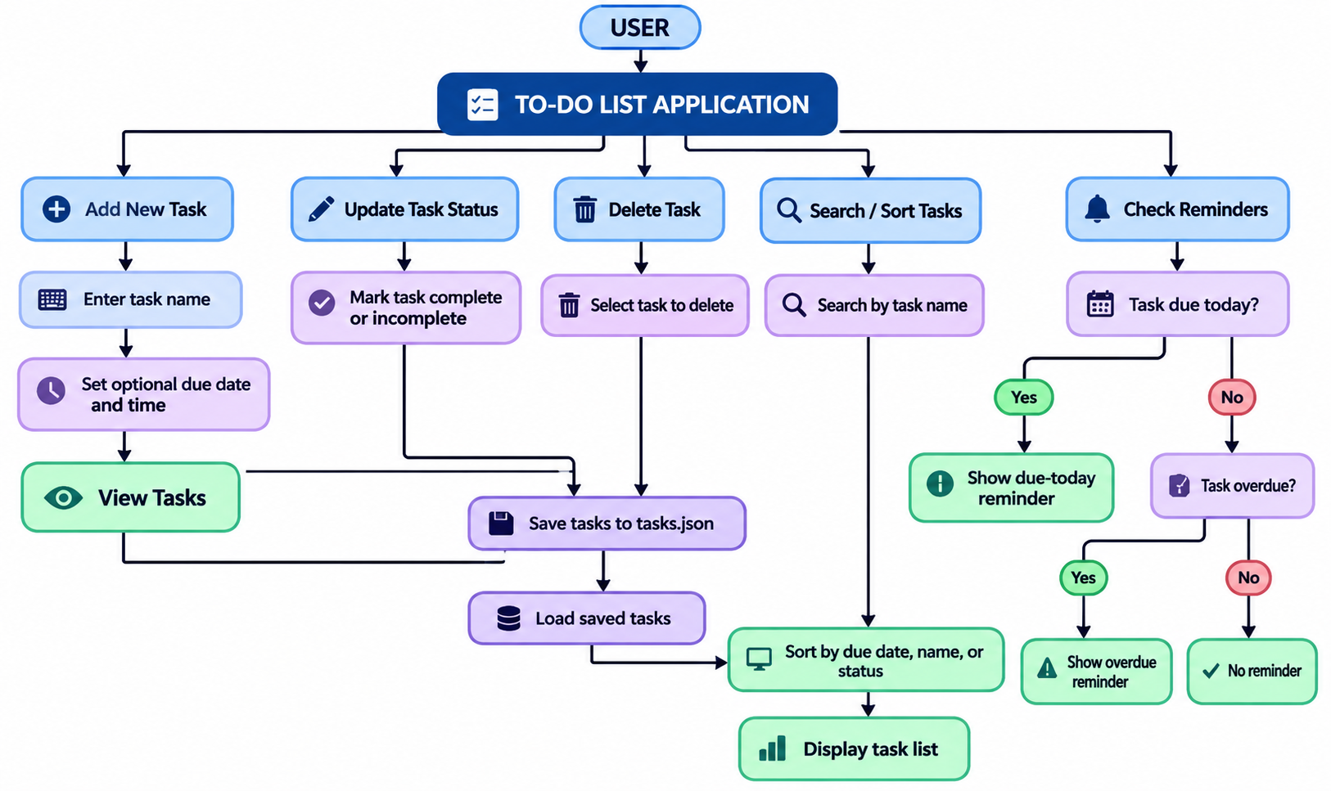
Work Flow Diagram

Slide 9
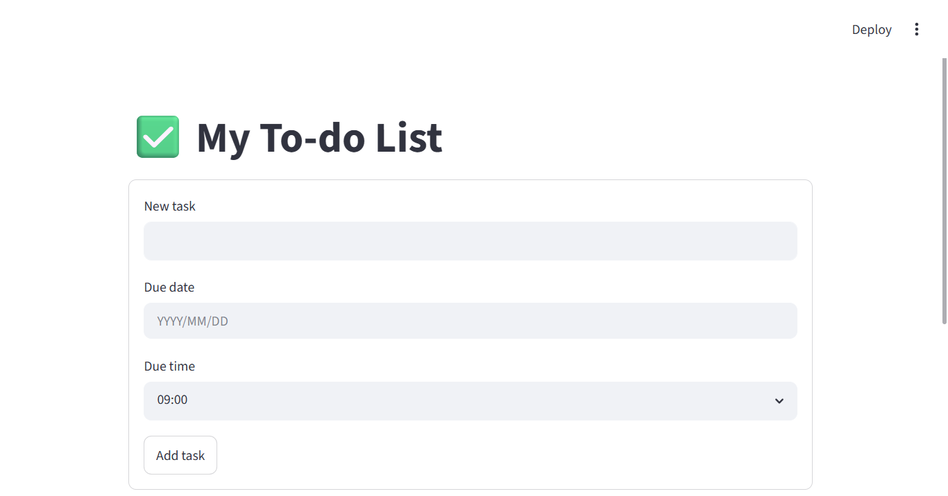
To-do list application
Insights
The to-do list keeps tasks organized in one place. Due dates and reminders help users stay on schedule. Search and completion status make tasks easy to manage.

Slide 10
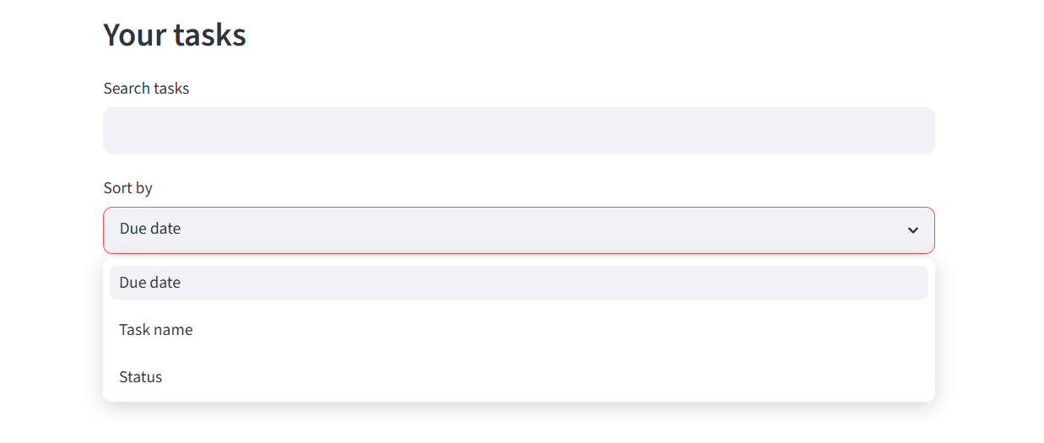
Status, search and sort of tasks
Insights
Mark tasks as completed using checkboxes. Search and filter tasks by name and organize tasks based on status

Slide 11
Recommendations
Edit task - Modify an existing task.
Priority levels - High, medium and low
Categories - Personal, work, education, wealth, etc.
Task status - Pending, In progress and completed.
Overdue Alerts - Highlight tasks past their deadlines.
Recurring Tasks - Daily, weekly and monthly tasks.

Slide 12
Conclusion
To-Do list Application provides a simple and effective way to manage daily activities and improve productivity. It allows users to create, view, search, sort, complete, and delete tasks while managing deadlines.
By using Python and Streamlit, the application offers a user-friendly interface and demonstrates the practical implementation of programming concepts such as CRUD operation, data managements and file handling.

Slide 13
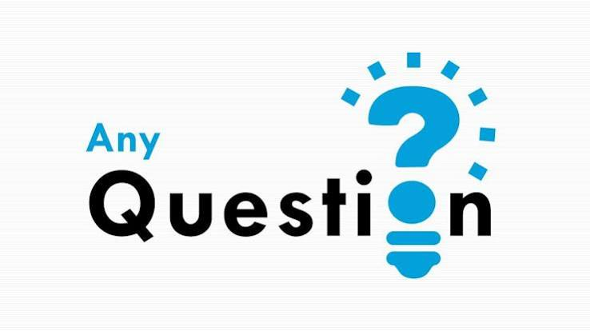

Slide 14

THANK YOU

